Slide 1
Blocking and Non-blocking Sockets

Slide 2
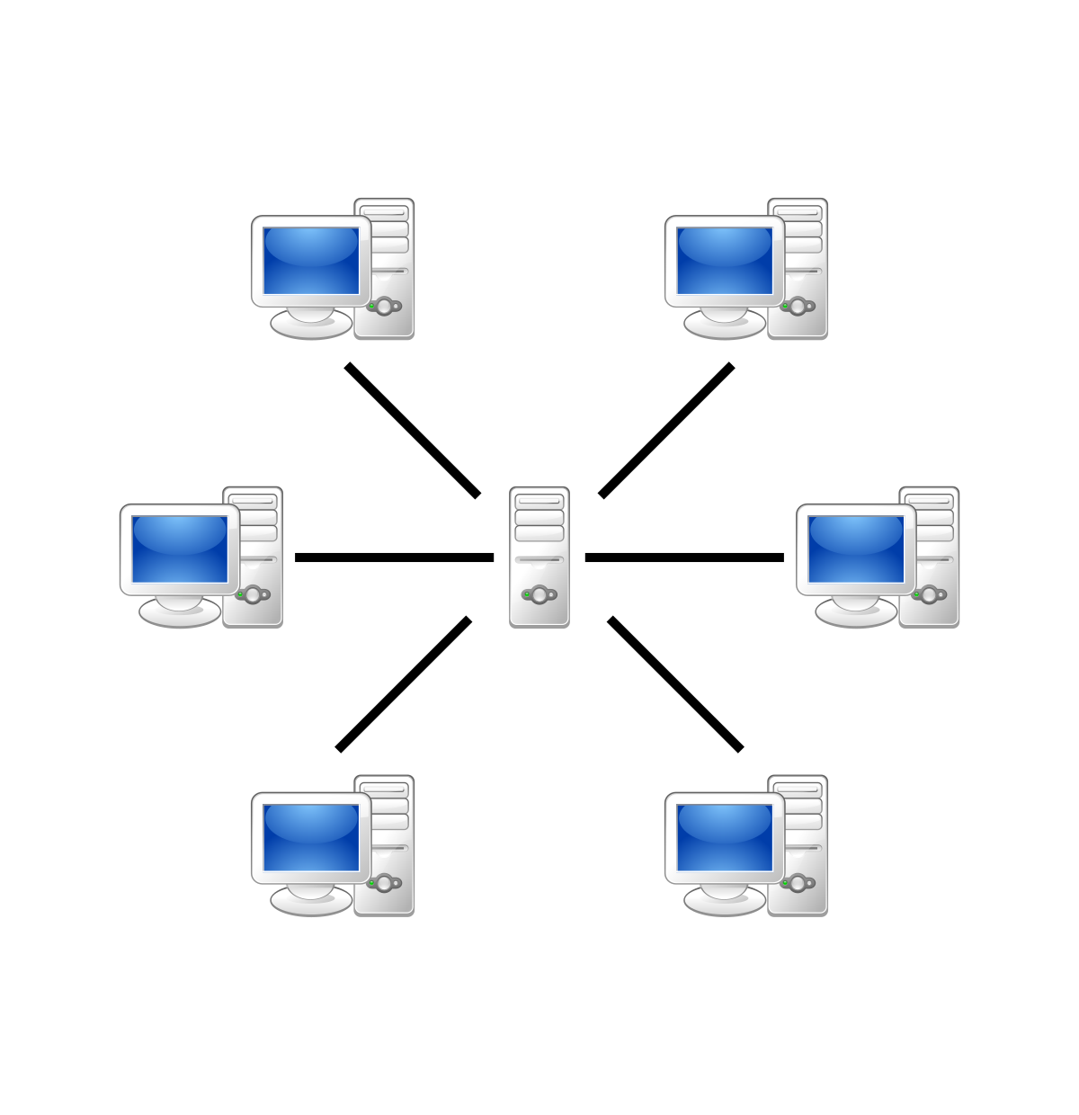
Blocking sockets
Think of how you would modify your code in Assignment 1 to chat with multiple clients simultaneously.
Here multiple clients are asking for evaluating different expressions simultaneously.

Slide 3
Blocking sockets
If you think deeply about it, you’ll notice that handling this situation is impossible using only the concepts in the previous assignment.
The reason is that accept(), read(), write()... are blocking system calls, meaning that the control is not returned to your program until some specific operation is complete.
For example, if you call the connect() method, the connection blocks your program until the operation is complete. On many occasions, we don't want to keep our program waiting forever.

Slide 4
Handling simultaneous connections
You are going to handle concurrency using 2 approaches:
Using fork() system call
“fork” a process for every new client it receives, such that each child process is responsible for handling the request of one client.
Using select() system call
“select” call to see which clients are making the requests (it can be connection request or read/write request) and serve the requests of multiple clients.

Slide 5
Bit more on “fork”ing
while(1){
newSocket = accept(sockfd, (struct sockaddr*)&newAddr, &addr_size);
if(newSocket < 0){
exit(1);
}
printf("Connection accepted from %s:%d\n", inet_ntoa(newAddr.sin_addr), ntohs(newAddr.sin_port));
if((childpid = fork()) == 0){
close(sockfd);
while(1){
recv(newSocket, buffer, 1024, 0);
if(strcmp(buffer, ":exit") == 0){
printf("Disconnected from %s:%d\n", inet_ntoa(newAddr.sin_addr), ntohs(newAddr.sin_port));
break;
}else{
printf("Client: %s\n", buffer);
send(newSocket, buffer, strlen(buffer), 0);
bzero(buffer, sizeof(buffer));
Do data transfer for individual clients through different child processes

Slide 6
Bit more on “select”ing
Fork processes difficult to code, debug and sometimes they have unpredictable results.
Overhead switching of context
Not scalable for large number of clients
Deadlocks can occur
A better way to handle multiple clients is by using select() linux command.
Select command allows to monitor multiple file descriptors, waiting until one of the file descriptors become active.
For example, if there is some data to be read on one of the sockets select will provide that information.
Select works like an interrupt handler, which gets activated as soon as any file descriptor sends any data.

Slide 7
Problem Statement
The protocol between the client and the server is as follows:
The client connects to the server and then asks the user for input. The user enters a simple arithmetic expression string in infix form (e.g., "1 + 2", "(5 + 6) * 8.9"). The user's input is sent to the server via the connected socket.
The server reads the user's input from the client socket, converts it into a postfix expression and then evaluates the postfix expression, and sends the result and the converted postfix expression back to the client as well as writes the following in a file named “server_records.txt” (at the beginning create an empty file).
<client_id> <infix_expr> <converted_expr><answer> <time_elapsed>
Note: The time elapsed is the time elapsed (in seconds) from when the server connected to this client to returning the response to this query.
The client should display the server's reply to the user, and prompt the user for the next input until the user terminates the client program.

Slide 8
Problem 1: Using the “fork” system call
Write two separate C programs, one for a TCP server (handles requests for multiple users) and another one for a client.
The server program will “fork” a process for every new client it receives, such that each child process is responsible for handling the request of one client.
Problem 2: Using the “select” system call
Write two separate C programs, one for a TCP server (handles requests for multiple users) and another one for a client.
The server uses the “select” call to see which clients are making the requests (it can be a
connection request or read/write request) and serve the requests of multiple clients.

Slide 9
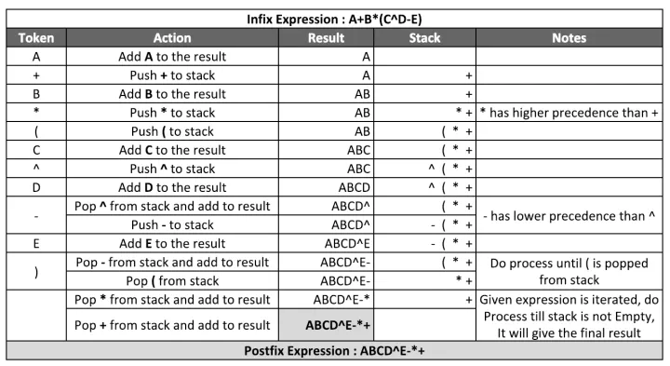
Infix to postfix

Slide 10
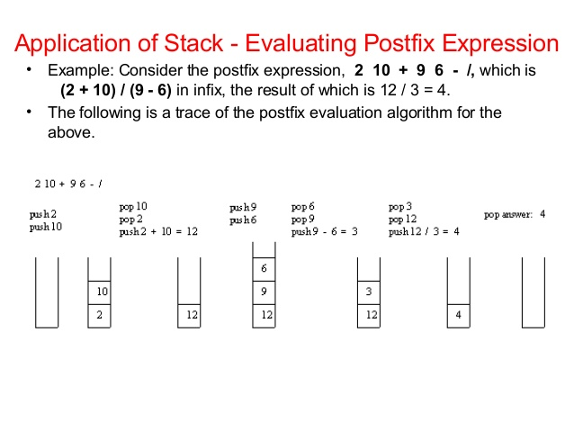

Slide 11
Submission
Deadline: 20 January 2021
Guidelines:
Create a folder where the folder name is “<roll_number>_Assgn2”.
Create two subfolders under the folder - problem1 and problem2.
Compress the parent folder (whose name is your roll number), upload the compressed folder at Moodle.

Slide 12
Tutorial links
1- Blocking vs Non-blocking call
https://www.scottklement.com/rpg/socktut/nonblocking.html
2- Select system call
http://www.tutorialspoint.com/unix_system_calls/_newselect.htm
3- Beej Guide
https://beej.us/guide/bgnet/pdf/bgnet_usl_c_1.pdf

